Slide 1


Toward Scalable Transaction Processing
Evolution of Shore-MT
Anastasia Ailamaki (EPFL)
Ryan Johnson (University of Toronto)
Ippokratis Pandis (IBM Research – Almaden)
Pınar Tözün (EPFL)

Slide 2
hardware parallelism: a fact of life
2005
2020
Core
Core
Core
Core
Core
Core
Core
Core
Core
Core
Core
Core
Core
Core
Core
Core
Core
pipelining
ILP
multithreading
multisocket multicores
(CMP)
heterogeneous CMP
“performance” = scalability

Slide 3
software parallelism doesn’t just “happen”
[EDBT2009]
10
Sun Niagara T1 (32 contexts) Contention-free workload
BerkeleyDB
CommercialDB
Throughput (tps/thread)
Postgres
1
MySql
Shore
0.1
0
8
16
24
32
# of Concurrent Threads
best scalability 30% of ideal

Slide 4
Shore-MT: an answer to multicore
Multithreaded version of SHORE
State-of-the-art DBMS features
Two-phase row-level locking
ARIES-style logging/recovery
  ARIES-KVL
  ARIES-IM
Similar at instruction-level with commercial DBMSs
Sun Niagara T1
Contention-free workload
10
shore-mt
commercialDB
Throughput (tps/thread)
1
[VLDB1990]
[SIGMOD1992]
shore
0.1
0
8
16
24
32
# of Concurrent Threads
test-bed for database research
infrastructure for micro-architectural analysis

Slide 5

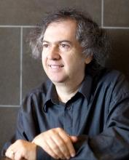


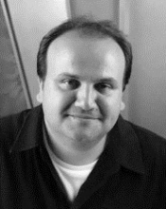
Shore-MT in the wild
Goetz Graefe (HP Labs)
  Foster B+Trees [TODS2012]
  Controlled lock violation [SIGMOD2013a]
Alan Fekete (U. Sydney)
  A Scalable Lock Manager for Multicores [SIGMOD2013b]
Tom Wenisch (U. Michigan)
  phase-change memory [PVLDB2014]
Steven Swanson (UCSD)
  non-volatile memories
Andreas Moshovos (U. Toronto)
  storage systems
… many more

Slide 6










Shore-MT 7.0
Improved portability
Reduced complexity in adding new workloads
Bug fixes
OS
CPU
Compiler
http://diaswww.epfl.ch/shore-mt

Slide 7
scaling-up OLTP on multicores
Extreme physical partitioning
  H-Store/VoltDB
  HyPer
Logical & Physiological partitioning
  Oracle RAC
  DORA/PLP on Shore-MT
Lock-free algorithms & MVCC
  TokuDB
  MemSQL
  Hekaton
[VLDB2007]
[ICDE2011]
[VLDB2001]
[PVLDB2010b,PVLDB2011]
[SPAA2005a]
[SIGMOD2013]

Slide 8
not all interference is bad
[VLDBJ2013]
unbounded
fixed
cooperative
locking, latching
transaction manager
logging
unbounded → fixed / cooperative

Slide 9
communication in Shore-MT

Slide 10
outline
introduction ~ 20 min
part I: achieving scalability in Shore-MT ~ 1 h
part II: behind the scenes ~ 20 min
part III: hands-on ~ 20 min

Slide 11
outline
introduction ~ 20 min
part I: achieving scalability in Shore-MT ~ 1 h
  taking global communication out of locking
  extracting parallelism in spite of a serial log
  designing for better communication patterns
part II: behind the scenes ~ 20 min
part III: hands-on ~ 20 min

Slide 12
hierarchical locking is good… and bad
Good: concurrent access to distinct tuples
update Customer set … where …
Database lock
IX (intent exclusive)
select * from LineItem where …
delete from from LineItem where …
Table lock
IX (intent exclusive)
[TPC-H]
LineItem
Customer
Row locks
X (exclusive)
bad: lock state update is complex and serial

Slide 13
inside the lock manager - acquire
Lock ID Hash Table
T1
Transaction Head
Lock Head
Requirements
Find/create many locks in parallel
Each lock tracks many requests
Each transaction tracks many locks
L1
Lock Request
L2
L3
Lock Manager

Slide 14
inside the lock manager - release
A
Compute new lock mode (supremum)
release()
…
…
IS
IS
S
IS
IX
IS
IS
upgrade(IX)
C
Grant new requests
B
Process upgrades
Lock strengths
IS < IX < S
intent locks => long request chains

Slide 15
hot shared locks cause contention
Hot lock
Cold lock
trx₁
trx₂
trx₃
Lock Manager
Agent thread execution
release and request the same locks repeatedly

Slide 16
How much do hot locks hurt?
Time breakdown (µs/xct)
LM contention
400
Shore-MT
Sun Niagara II (64 core)
Telecom workload
Other contention
300
LM overhead
Computation
200
100
0
2%
11%
48%
67%
86%
98%
System load
Answer: pretty bad (especially for short transactions)
even worse: these are share-mode locks!

Slide 17
speculative lock inheritance
[VLDB2009]
Seed lock list
of next tx
Commit without
releasing hot locks
Hot lock
Cold lock
trx₁
trx₂
trx₃
Lock Manager
Contention
reduced
Agent thread execution
small change; big performance impact

Slide 18
impact of SLI on communication
fixed
unbounded
avoiding the unbounded communication

Slide 19
outline
introduction ~ 20 min
part I: achieving scalability in Shore-MT ~ 1 h
  taking global communication out of locking
  extracting parallelism in spite of a serial log
  designing for better communication patterns
part II: behind the scenes ~ 20 min
part III: hands-on ~ 20 min

Slide 20

WAL: gatekeeper of the DBMS
Write ahead logging is a performance enabler
Xct update:
Xct commit:
With WAL
No WAL
but… logging is completely serial (by design!)

Slide 21
a day in the life of a serial log
[PVLDB2010a]
WAL
Commit
B
Lock Mgr.
Xct 1
END
A
Log Mgr.
C
Working
I/O Wait
Xct 2
WAL
Serialize
A
Serialize at the log head
B
I/O delay to harden the commit record
C
Serialize on incompatible lock

Slide 22
early lock release
Xct 1 will not access any data after commit… why keep locks?
WAL
Commit
Xct 1
END
Lock Mgr.
Log Mgr.
Working
Xct 2
I/O Wait
WAL
Serialize
WAL
Xct 1
END
Commit
NOTE: Xct 2 must not commit or produce output until Xct 1 is durable
(no longer enforced implicitly by log)
Xct 2
WAL
no overhead, eliminates lock amplification

Slide 23
a day in the life of a serial log
WAL
B
Xct 1
END
Lock Mgr.
Commit
A
Log Mgr.
Working
Xct 2
I/O Wait
WAL
Serialize
A
Serialize at the log head
B
I/O delay to harden the commit record
Serialize on incompatible lock

Slide 24
a day in the life of a serial log
WAL
Xct 1
Xct 2
Commit
Xct 3
…
Xct N
Log commit => 1+ context switches per xct
  Bad: each context switch wastes 8-16µs CPU time
  Worse: OS can “only” handle ~100k switches/second
Group commit doesn’t help
  Block pending on completion signal (instead of on I/O)
let someone else process the completion!

Slide 25
commit pipelining
Request log sync but do not wait
Detach transaction state and enqueue it somewhere
(xct nearly stateless at commit)
Dedicate 1+ workers to commit processing
Log Writer
Time
Thread 1
Xct 1
Xct 3
Thread 2
Xct 2
Xct 4
commit rate no longer tied to OS & I/O

Slide 26
a day in the life of a serial log
WAL
Xct 1
ENQUEUE
Lock Mgr.
Commit
A
Log Mgr.
Working
Xct 2
I/O Wait
WAL
Serialize
A
Serialize at the log head
I/O delay to harden the commit record
Serialize on incompatible lock

Slide 27
a day in the life of a serial log
WAL
Xct 1
ENQUEUE
Commit
Xct 2
Xct 3
Xct 4
Log insertion becomes a bottleneck for large numbers of threads on modern machines

Slide 28
insight: aggregate waiting requests
WAL
Xct 1
ENQUEUE
Inspiration: “Using elimination to implement scalable and lock-free FIFO queues” [SPAA2005b]
Commit
Xct 2
Xct 3
Xct 4
Xct 5
Xct 6

Slide 29
insight: aggregate waiting requests
WAL
Xct 1
ENQUEUE
Inspiration: “Using elimination to implement scalable and lock-free FIFO queues” [SPAA2005b]
Commit
Xct 2
Xct 3
Xct 4
Xct 5
Xct 6
Self-regulating:
longer queue -> larger groups -> shorter queue
decouple contention from #threads & log entry size

Slide 30
impact of logging improvements
fixed
unbounded
same amount of communication, but well-behaved

Slide 31
performance impact of SLI&Aether
  Sandy Bridge (Intel Xeon E5-2650)
  2GHz, 64GB RAM, 2-socket 8-core
  TATP

Slide 32
outline
introduction ~ 20 min
part I: achieving scalability in Shore-MT ~ 1 h
  taking global communication out of locking
  extracting parallelism in spite of a serial log
  designing for better communication patterns
part II: behind the scenes ~ 20 min
part III: hands-on ~ 20 min

Slide 33
shared-everything
Workers
natassa
ippokratis
ryan
pınar
Logical
Physical
contention due to unpredictable data accesses

Slide 34
thread-to-transaction – access pattern
unpredictable data accesses
clutter code with critical sections -> contention

Slide 35
data-oriented transaction execution
[PVLDB2010b]
Transaction does not dictate the data accessed by worker threads
Break each transaction into smaller actions
  Depending on the data they touch
Execute actions by “data-owning” threads
Distribute and privatize locking across threads
new transaction execution model
convert centralized locking to thread-local

Slide 36
thread-to-data – access pattern
predictable data access pattern
opens the door to many optimizations

Slide 37
input: transaction flow graph
Graph of Actions & Rendezvous Points
Actions
  Operation on specific database
  Table/Index it is accessing
  Subset of routing fields
Rendezvous Points
  Decision points (commit/abort)
  Separate different phases
  Counter of the # of actions to report
  Last to report initiates next phase
TPC-C Payment
Upd(WH)
Upd(DI)
Upd(CU)
Phase 1
Phase 2
Ins(HI)

Slide 38
partitions & executors
Routing table at each table
  {Routing fields → executor}
Executor thread
  Local lock table
    {RoutingFields + partof(PK), LockMode}
    List of blocked actions
  Input queue
    New actions
  Completed queue
    On xct commit/abort
    Remove from local lock table
  Loop completed/input queue
  Execute requests in serial order
Routing fields: {WH_ID, D_ID}
Range | Executor
A-H | 1
I-N | 2
Completed
Local Lock Table
A
Pref
LM
Own
Wait
{1,0}
EX
A
A
{1,3}
EX
B
B
A
A
Input

Slide 39
DORA’s impact on communication
fixed
unbounded
re-architected the unbounded communication

Slide 40
physical conflicts
Range | Worker
A – M
N – Z
Logical
Physical
Index
Heap
conflicts on both index & heap pages

Slide 41
physiological partitioning (PLP)
[PVLDB2011]
Range | Worker
A – M
N – Z
Logical
Physical
Index
R1
R2
Heap
latch-free physical accesses

Slide 42
road to scalable OLTP
fixed
unbounded
eliminated 90% of unbounded communication

Slide 43
performance impact of DORA&PLP
  Sandy Bridge (Intel Xeon E5-2650)
  2GHz, 64GB RAM, 2-socket 8-core
  TATP

Slide 44
outline
introduction ~ 20 min
part I: achieving scalability in Shore-MT ~ 1 h
part II: behind the scenes ~ 20 min
  Characterizing synchronization primitives
  Scalable deadlock detection
part III: hands-on ~ 20 min

Slide 45
lots of little touches in Shore-MT
“Dreadlocks” deadlock detection since 2009
Variety of efficient synchronization primitives
Scalable hashing since 2009
  Lock table: fine-grained (per-bucket) latching
  Buffer pool: cuckoo hashing
Multiple memory management schemes
  Trash stacks, region allocators
  Thread-safe slab allocators, RCU-like “lazy deletion”
Scalable page replacement/cleaning

Slide 46
Deadlock detection is hard!
Conservative
Timeout
Graph

Slide 47
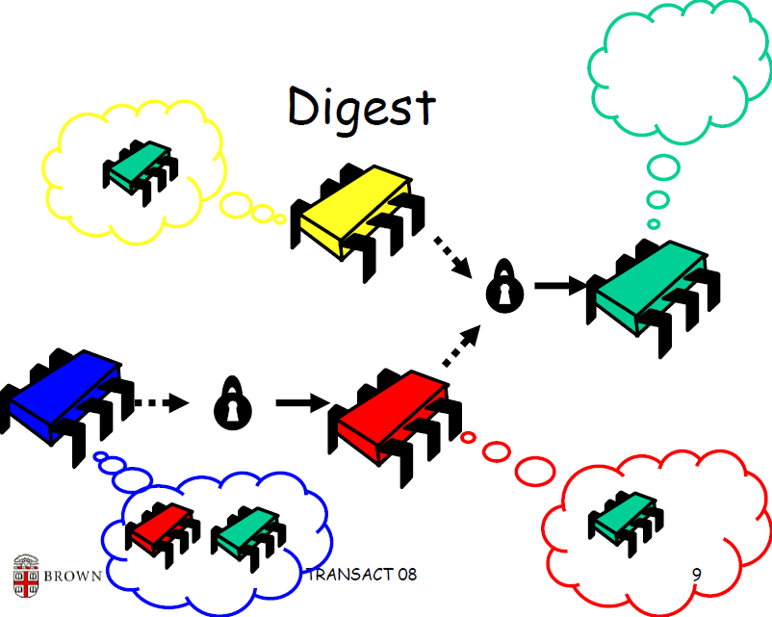
dreadlocks ^{[SPAA2008]}
Source: http://wwwa.unine.ch/transact08/slides/Herlihy-Dreadlocks.pdf

Slide 48
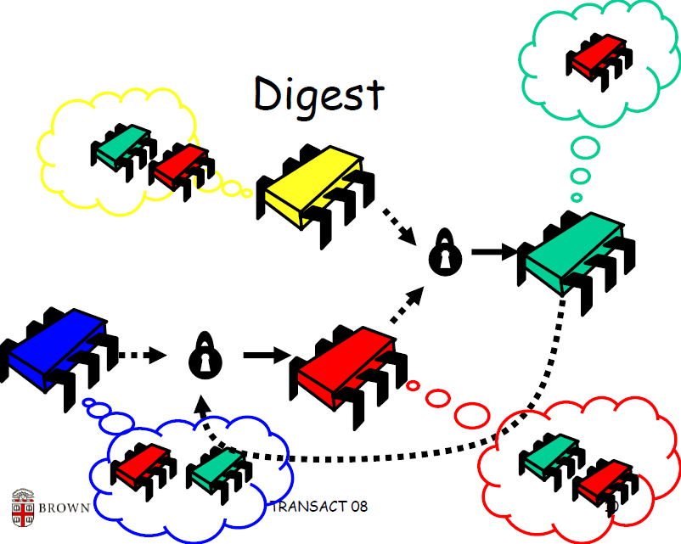
dreadlocks ^{[SPAA2008]}

Slide 49
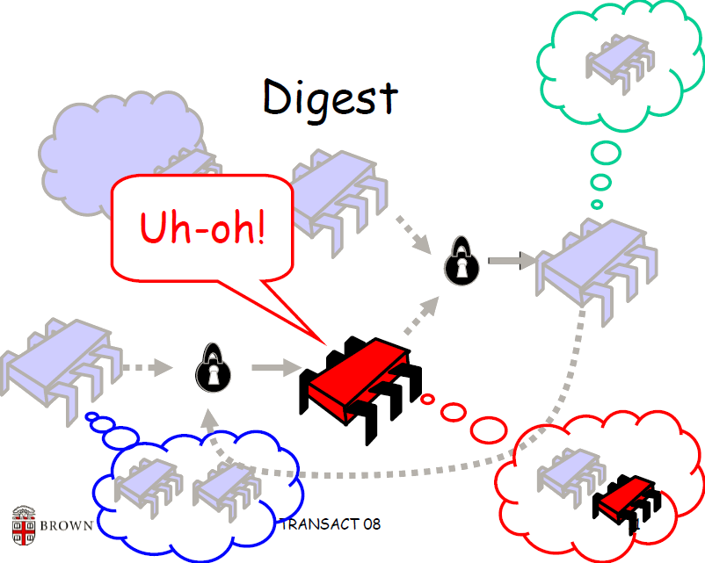
dreadlocks ^{[SPAA2008]}
simple, scalable, & efficient! choose any three

Slide 50
locks and latches aren’t everything
Synchronization required for one index probe (non-PLP)
Locks
Latches
Critical Sections
Time
Critical sections protect log buffer, stats, lock and latch internal state, thread coordination…
diverse use cases, selecting the best primitive?

Slide 51
lock-based approaches
Blocking OS mutex
 | ü Simple to use | û Overhead, unscalable
Test and set spinlock (TAS)
 | ü Efficient | û Unscalable
Queue-based spinlock (“MCS”)
 | ü Scalable | û Mem. management
Reader-writer lock
 | ü Concurrent readers | û Overhead

Slide 52
lock-free approaches
Atomic updates
 | ü Efficient | û Limited applicability
Lock-free algorithms
 | ü Scalable | û Special-purpose algs
Optimistic concurrency control (OCC)
 | ü Low read overhead | û Writes cause livelock
Hardware approaches (e.g. transactional memory)
 | ü Efficient, scalable | û Not widely available

Slide 53
synchronization “cheat sheet”
Duration
Contention
Doesn’t matter
OCC
MCS
Lock-free
TAS
MCS
TAS
Contention
Read-mostly
Write-mostly
OS blocking mutex: only for scheduling
Reader-writer lock: dominated by OCC/MCS
Lock-free: sometimes (but be very, very careful)

Slide 54
outline
introduction ~ 20 min
part I: achieving scalability in Shore-MT ~ 1 h
part II: behind the scenes ~ 20 min
part III: hands-on ~ 20 min

Slide 55
Shore-MT: first steps
Download
  hg clone https://bitbucket.org/shoremt/shore-mt
Build
  ./bootstrap
  ./configure --enable-dbgsymbols(optional)
  [in SPARC/Solaris: CXX=CC ./configure ...]
  make –j
Storage manager (sm)
  Quick tests, experiments: src/sm/tests

Slide 56
Shore-MT API
src/sm/sm.h
  API function declarations and documentation
src/sm/smindex.cpp
  Implementation of the index related API functions
src/sm/smfile.cpp
  Implementation of the record file related API functions

Slide 57
concurrency control in Shore-MT
Concurrency Control
t_cc_none | t_cc_record
t_cc_page | t_cc_file
t_cc_vol
t_cc_kvl (default)
t_cc_im (default in kits)
Locks
Volume
Store (Files, Indexes)
Key-Value
Page
Record
Extent
Key-Value
t_cc_kvl: if index is unique <key> else <key, value>
t_cc_im: <value> (actually, record-id)

Slide 58
Shore-Kits
Application layer for Shore-MT
Available benchmarks:
  OLTP: TATP, TPC-B, TPC-C, TPC-E
  OLAP: TPC-H, Star schema benchark (SSB)
  Hybrid: TPC-CH (coming-up)

Slide 59
download & build Shore-Kits
Download
  hg clone https://bitbucket.org/shoremt/shore-kits
Build
  ln –s <shore-storage-manager-dir>/m4
  ./autogen.sh
  ./configure --with-shore=<shore-storage-manager-dir>
  --with-glibtop(for reporting throughput periodically)
  --enable-debug(optional)
  [in SPARC/Solaris: CXX=CC ./configure ...]
  make -j

Slide 60
Shore-Kits: directory structure
src|include/sm
  Interaction with Shore-MT API
src|include/workloads
  Workload implementations for baseline Shore-MT
src|include/dora
  DORA/PLP logic and workload implementations
shore.conf
  Where you specify workload parameters

Slide 61
how to run Shore-Kits?
ln –s log log-tpcb-10
rm log/*; rm databases/*
./shore_kits –c tpcb-10 –s baseline –d normal –r
  help
  trxs
  elr
  log cd
  measure 10 1 10 10 0 1
<restart>

Slide 62
some advice for benchmarking
For in-memory runs
  Your laptop might suffer (mine does ☺)
  Unless you want convoys, make sure
    #loaders, #clients, #workers used < #available hardware contexts
If you want high utilization
  Do not have synchronous clients
  (e.g. asynch option in VoltDB)
  Or make your clients send requests in large batches
  (e.g. shore-kits, db-cl-batchsz parameter in shore.conf)
  Group commit and commit pipelining won’t improve throughput if all outstanding requests are in the group!

Slide 63
more advice for benchmarking
Use fixed-duration measurement runs
(e.g. “measure” command in shore-kits)
  Start workers, snapshot stats, wait, snapshot stats again, stop workers; result is delta between snapshots.
  Avoids start/stop effects
  Duration of runs more predictable
  (even if throughput is unexpectedly low or high)
Run long enough to catch log checkpointing
  Checkpoints do impact performance, unfair to ignore them
  Gives page cleaning time to ramp up as well

Slide 64
why shore-kits isn’t enough?
Shore-Kits is great, but …
  Implementation overhead for simple queries
  Does not keep metadata persistently
  Does not allow ad-hoc requests
  Cannot switch databases on-the-fly
coming soon: Shore-Kits++

Slide 65
Closing Remarks
Hardware keeps giving more parallelism
But achieving scalability is hard
Any unbounded communication eventually becomes a bottleneck
Shore-MT and Shore-Kits
  Good test-bed for research
  New release: 7.0
  Check http://diaswww.epfl.ch/shore-mt/
Thank you!

Slide 66
References – I
[VLDB1990] C. Mohan: ARIES/KVL: a key-value locking method for concurrency control of multiaction transactions operating on B-tree indexes.
[SIGMOD1992] C. Mohan, F. Levine: ARIES/IM: an efficient and high concurrency index management method using write-ahead logging.
[VLDB2001] T. Lahiri, V. Srihari, W. Chan, N. MacNaughton, S. Chandrasekaran: Cache Fusion: Extending Shared-Disk Clusters with Shared Caches.
[SPAA2005a] M.A. Bender, J.T. Fineman, S. Gilbert, B.C. Kuszmaul: Concurrent cache-oblivious B-trees.
[SPAA2005b] M. Moir, D. Nussbaum, O. Shalev, N. Shavit: Using elimination to implement scalable and lock-free FIFO queues.
[VLDB2007] M. Stonebraker, S. Madden, D. J. Abadi, S. Harizopoulos, N. Hachem, P. Helland: The End of an Architectural Era (It's Time for a Complete Rewrite).
[SPAA2008] E. Koskinen, M. Herlihy: Dreadlocks: Efﬁcient Deadlock Detection.
[DaMoN2008] R. Johnson, I. Pandis, A. Ailamaki: Critical Sections: Re-Emerging Scalability Concerns for Database Storage Engines.

Slide 67
References – II
[EDBT2009] R. Johnson, I. Pandis, N. Hardavellas, A. Ailamaki, B. Falsafi: Shore-MT: a scalable storage manager for the multicore era.
[VLDB2009] R. Johnson, I. Pandis, A. Ailamaki: Improving OLTP Scalability using Speculative Lock Inheritance.
[PVLDB2010a] R. Johnson, I. Pandis, R. Stoica, M. Athanassoulis, A. Ailamaki: Aether: A Scalable Approach to Logging.
[PVLDB2010b] I. Pandis, R. Johnson, N. Hardavellas, A. Ailamaki: Data-Oriented Transaction Execution.
[PVLDB2011] I. Pandis, P. Tözün, R. Johnson, A. Ailamaki: PLP: Page Latch-free Shared-everything OLTP.
[ICDE2011] A. Kemper, T. Neumann: HyPer – A hybrid OLTP & OLAP main memory database system based on virtual memory snapshots.
[TODS2012] G. Graefe, H. Kimura, H. Kuno: Foster B-trees.
[VLDBJ2013] R. Johnson, I. Pandis, A. Ailamaki: Eliminating unscalable communication in transaction processing.

Slide 68
References – III
[SIGMOD2013] C. Diaconu, C. Freedman, E. Ismert, P. Larson, P. Mittal, R. Stonecipher, N. Verma, M. Zwilling: Hekaton: SQL Server's Memory-Optimized OLTP Engine.
[SIGMOD2013a] G. Graefe, M. Lillibridge, H. Kuno, J. Tucek, A. Veitch: Controlled Lock Violation.
[SIGMOD2013b] H. Jung, H. Han, A. Fekete, G. Heiser, H. Yeom: A Scalable Lock Manager for Multicores.
[PVLDB2014] Pelley et al

